Slide 1
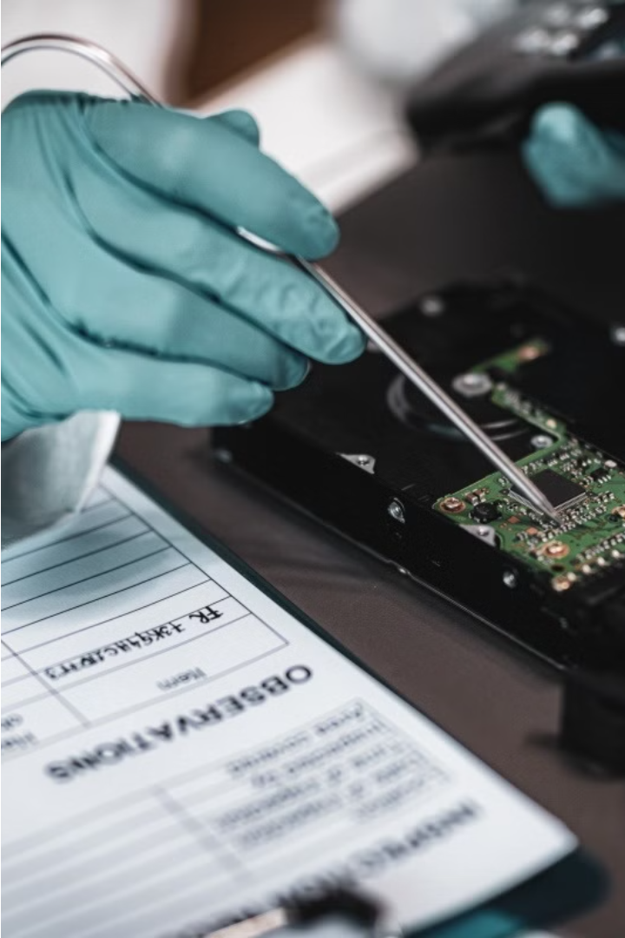

Introduction to Digital Forensics
Digital forensics is the process of investigating digital devices and data to uncover evidence of crimes or other incidents. This field combines technical expertise in computer science, cybersecurity, and law to systematically examine digital evidence and reconstruct events.

Slide 2

What is Digital Forensics?
Digital forensics is the process of identifying, collecting, analyzing, and preserving digital evidence to uncover and investigate digital crimes or incidents. It involves the systematic examination of electronic devices and data to recover and interpret information that can be used in legal proceedings.

Slide 3
Importance of Digital Forensics
Uncovering Digital Crimes
Incident Response
Digital forensics plays a crucial role in investigating and prosecuting cybercrimes, such as fraud, hacking, and data breaches, by retrieving and analyzing digital evidence.
Digital forensics helps organizations respond effectively to security incidents by identifying the root cause, containing the damage, and implementing appropriate remediation measures.
Legal Proceedings
Proactive Security
Digital evidence gathered through forensic analysis is often admissible in court, making it essential for building strong legal cases and ensuring fair trials.
By understanding the techniques and methods used by cybercriminals, digital forensics professionals can help organizations develop more robust security measures to prevent future attacks.

Slide 4
Types of Digital Evidence
1
Documents and Files
2
System Logs
Text documents, spreadsheets, images, videos, and other electronic files can contain critical evidence for investigations.
Computer, network, and application logs provide valuable timestamps and records of digital activity.
3
Mobile Device Data
4
Internet Records
Smartphones, tablets, and other mobile devices can hold call logs, messages, location data, and other potentially incriminating information.
Browser history, search queries, emails, and online accounts may reveal an individual's digital footprint and online behavior.

Slide 5
Digital Forensics Process
1
Identification
Recognize potential digital evidence
2
Preservation
Secure and protect digital evidence
3
Collection
Gather and extract digital data
4
Analysis
Examine and interpret digital evidence
The digital forensics process involves a systematic approach to identifying, preserving, collecting, and analyzing digital evidence. This methodical workflow ensures the integrity and admissibility of the evidence, enabling investigators to reconstruct digital events and uncover critical insights.

Slide 6




Data Acquisition and Preservation
Data Acquisition
Preservation
Best Practices
Collecting digital evidence from various sources like computers, smartphones, or cloud storage in a forensically sound manner.
Ensuring the integrity of digital evidence by maintaining the original state and chain of custody throughout the investigation process.
Adhering to established protocols and guidelines to ensure the admissibility and reliability of digital evidence in legal proceedings.

Slide 7
Digital Forensics Tools and Techniques
Forensic Imaging
Data Recovery
Network Forensics
Mobile Forensics
Forensic imaging involves creating a bit-for-bit copy of a digital device's storage, preserving evidence in its original state for analysis.
Specialized software can recover deleted or hidden files, extracting crucial evidence from damaged or corrupted storage devices.
Extracting data from smartphones, tablets, and other mobile devices is crucial for investigating incidents involving these ubiquitous technologies.
Network traffic analysis, firewall logs, and network device configurations provide insights into digital crimes and security breaches.

Slide 8
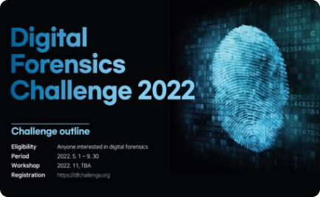
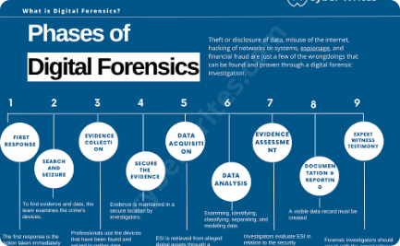

Challenges in Digital Forensics
Rapidly Evolving Technology
Massive Data Volumes
Evolving Legal Landscape
The exponential growth in digital data creates immense challenges in identifying, acquiring, and analyzing relevant evidence from vast data sets.
Digital forensics must keep pace with the rapid advancements in technology, including new devices, encryption methods, and data storage techniques.
Digital forensics professionals must navigate a complex and ever-changing legal framework to ensure the admissibility and integrity of digital evidence.

Slide 9



Legal and Ethical Considerations
Legal Compliance
Ethical Practices
Expert Testimony
Digital forensics must adhere to strict legal guidelines to ensure evidence is collected and handled properly, protecting the rights of all parties involved.
Practitioners must uphold the highest ethical standards, respecting privacy, maintaining impartiality, and preventing misuse of sensitive data throughout the investigation.
Digital forensic experts may be required to provide expert testimony in legal proceedings, necessitating a thorough understanding of courtroom procedures and rules of evidence.

Slide 10
Career Opportunities in Digital Forensics
Law Enforcement
Cybersecurity
Digital forensic investigators are crucial for law enforcement agencies, helping to gather and analyze digital evidence for criminal investigations.
Organizations rely on digital forensics experts to identify and respond to cyber threats, data breaches, and other security incidents.
Private Sector
Consulting
Digital forensics skills are in high demand in industries like finance, healthcare, and technology, where experts help investigate fraud, data leaks, and other digital crimes.
Digital forensics consultants provide specialized expertise to clients, assisting with incident response, litigation support, and expert witness testimony.

